Slide 1
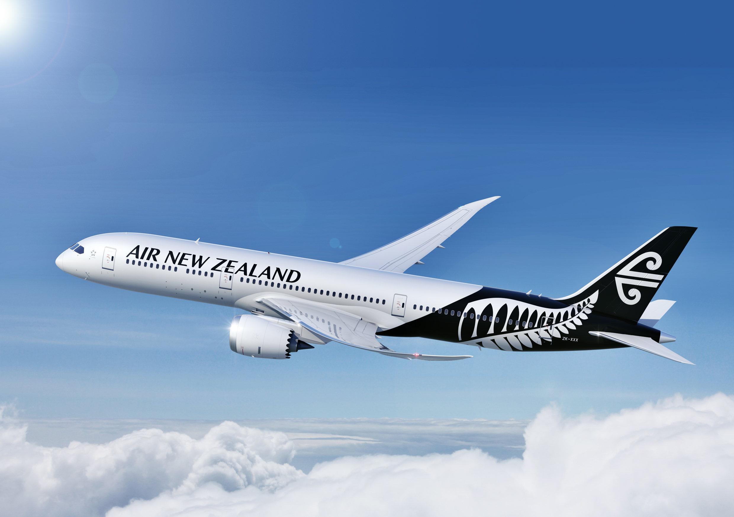

AIR NEW ZEALAND-INDIAN DOMESTIC MARKET
The world’s warmest welcome
PRESENTED BY:
ABHISHEK RANJAN
SAMRUDH SAMARTH
ADITYA PAWAR
ASHISH KUMAR

Slide 2
CONTENTS
INTRODUCTION
2022 BY THE NUMBERS
REVENUE
EXPENSES
PASSENGERS
OWNERSHIP & SHAREHOLDERS
COMPETITORS
FINANCIAL ANALYSIS
PASSENGER TRAFFIC STATISTICS
PASSENGER TRAFFIC TRENDS Y-O-Y
MARKET SHARE % IN TERMS OF DOMESTIC MARKET DEMANDS (RPK)
FINANCIAL SUMMARY OF ALL SCHEDULE – INDIAN CARRIERS
APPROXIMATE COST STRUCTURE OF AVIATION INDUSTRY IN INDIA
INDIAN CARGO MARKET
OPPORTUNITY IN INDIAN AVIATION SECTOR
OPERATION COST PER ASK
CHALLENGES FACED BY THE AVIATION INDUSTRIES IN INDIA
RISKS
BREAKEVEN PERIOD (GUESSTIMATES)
DECISION

Slide 3
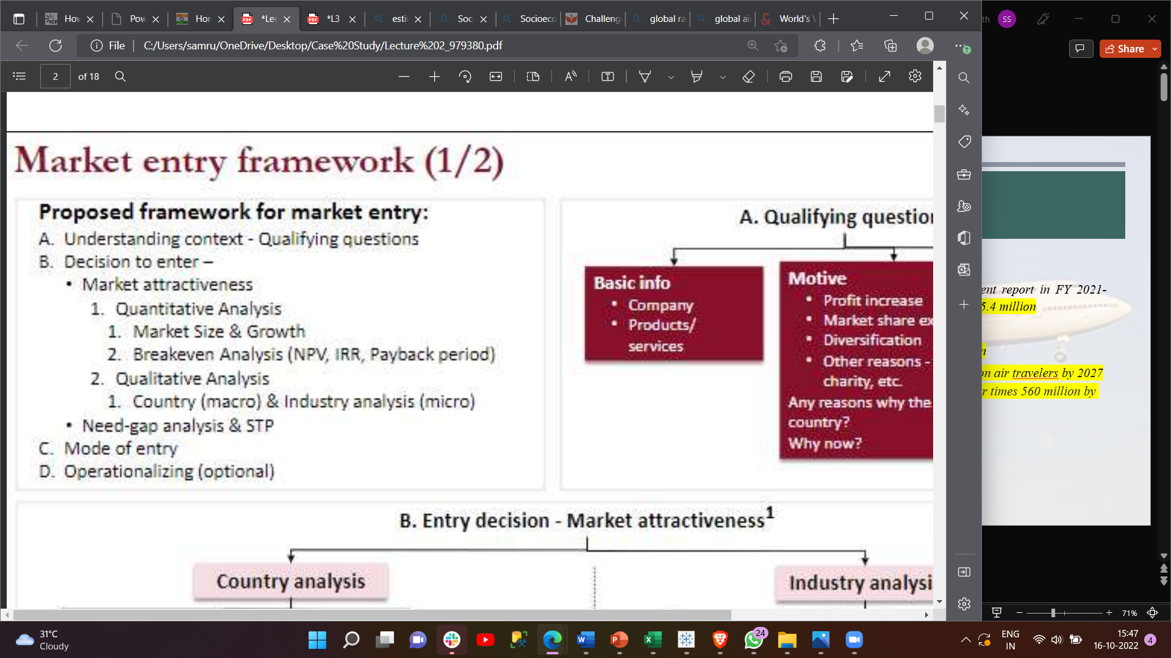
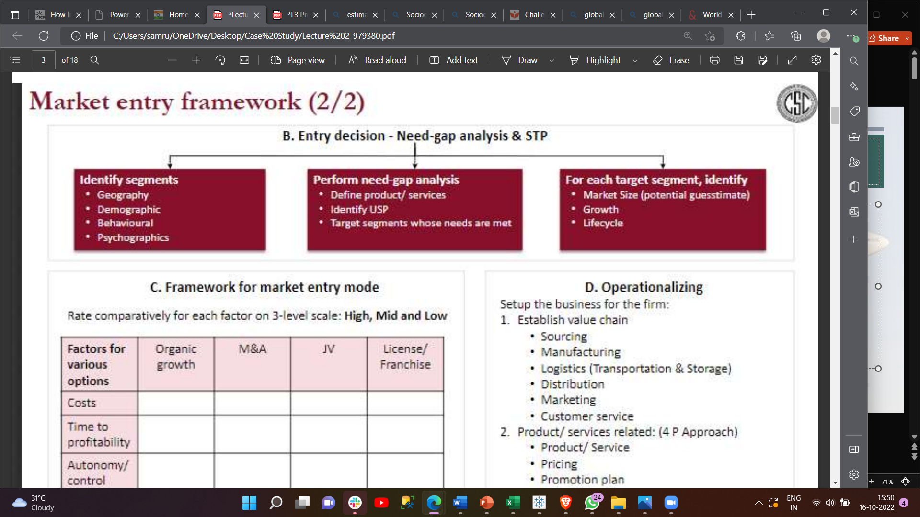
For you case study we use market entry framework.

Slide 4
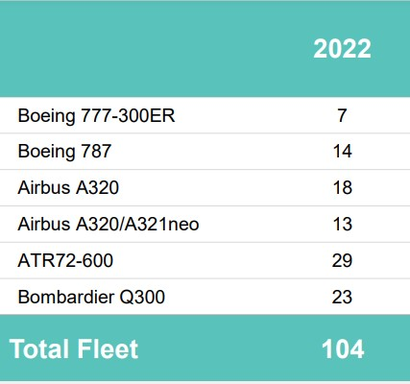
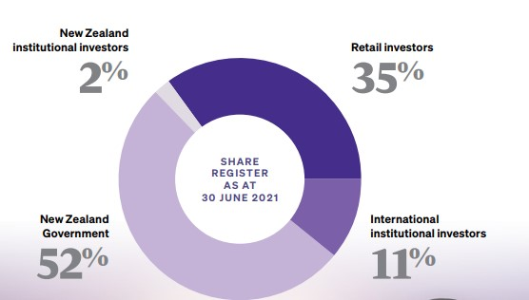
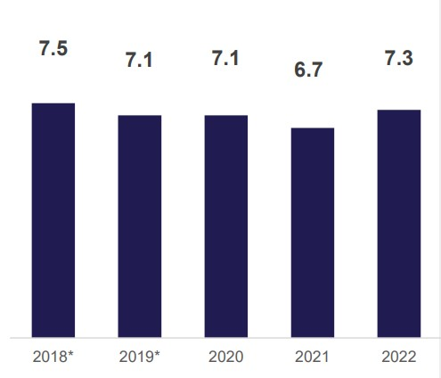
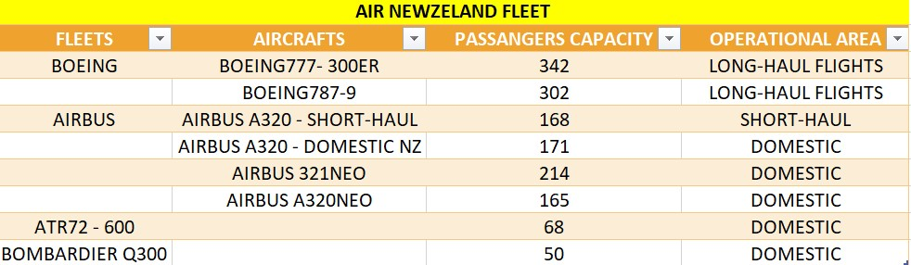
INTRODUCTION
The Air New Zealand Group operates a global network that provides air passenger services and cargo transport services
within New Zealand, to and from Australia, the Pacific, Asia, North America, South America, and the UK.
Founded - 26 April 1940
Commenced operations – 01 April 1965
Based in Auckland
Alliance – Star Alliance since 1999
Fleet size – 104 ( As per 2022)
Destination – 52 (20 domestic 32 International)
No of employees – 8.9 k
Parent Company – New Zealand Government
Aircraft fleet avg age in years – 7.3 (2022)
Passenger Capacity of Boeing aircrafts is most
and of Bombardier Q300 is least.

Slide 5

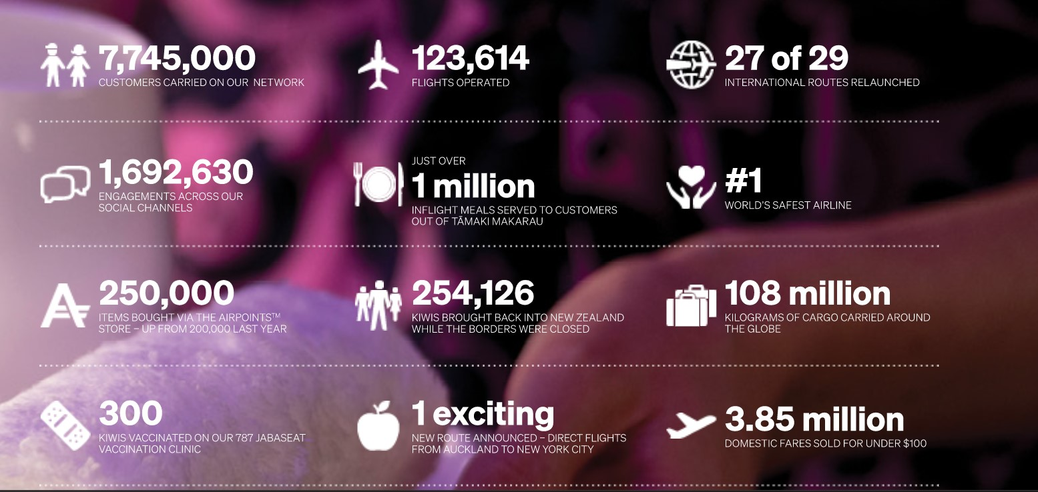

Slide 6
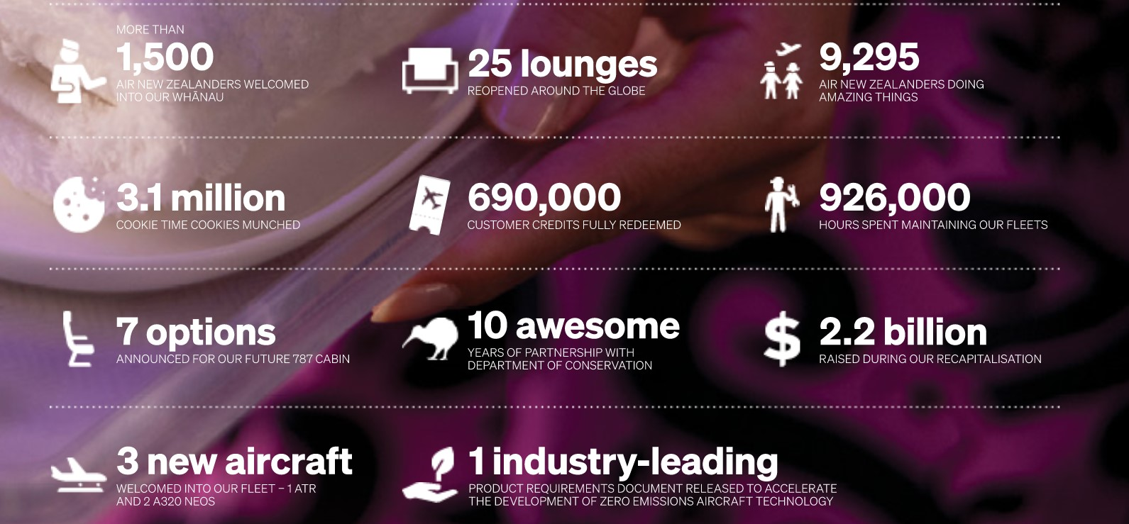

Slide 7
REVENUE
Operating revenue for the year increased 8.6% to NZ$2.7B.
pre-tax loss of NZ$725 million ($450m) for the year ended June 30, 2022 (FY22).
net loss of NZ$591 Million ($366m), more than double last year's net loss of NZ$292 million ($181m).
The statutory loss was NZ$810 million ($502m), compared to NZ$415 million ($257m) last year.
Total capacity (Available seat Kilometers, ASK) including cargo only flights increased 15% compared to the same period last year.
Passenger revenue remained stable at $1.5B.
Capacity increased by 3.4%.
Demand (Revenue passenger Kilometers, RPK) increased more than capacity, resulting in a load factor of 67.1%, an increase of 9.8% points on the prior year.
Revenue for available seat Kilometers (RASK) decreased 2.9%.
International long haul capacity increased by 17% (excluding cargo-only flights).
Cargo revenue – NZ$1.0 B, an increase of 32%

Slide 8
EXPENSES
Operating expenditure increased by NZ$555M or 25%, to NZ$2.7B.
Labour cost were NZ$976M increasing by NZ$146M or 18%.
Foreign exchange has no impact for the year.
Fuel cost were NZ$560M increasing by NZ$249M or 80%.
Fuel consumption increased 14% in the year due to 15% increase in capacity due to passenger and cargo-only flying resulting in an additional NZ$41M in cost.
Weaker NZ dollar also resulted in fuel cost increase of NZ$16M.
Aircraft operations passenger services and maintenance cost were NZ$787M, an increase of NZ$99M or 14%.
Sales, Marketing and other expenses were NZ$412M growing NZ$87M or 27%.
Ownership cost decreased by NZ$49M or 6.1%.

Slide 9
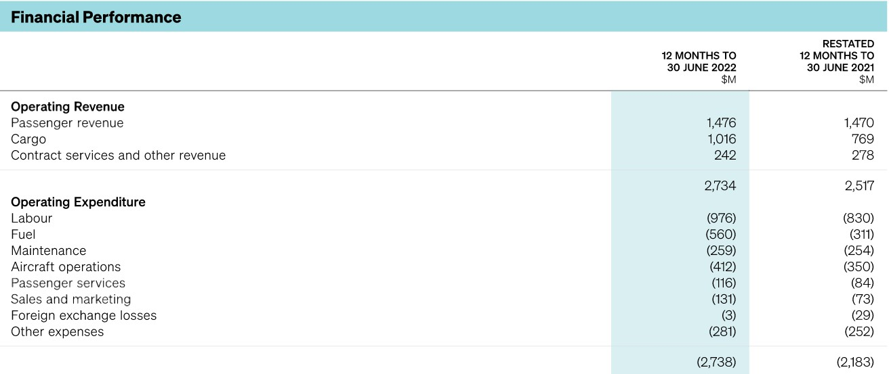

Slide 10
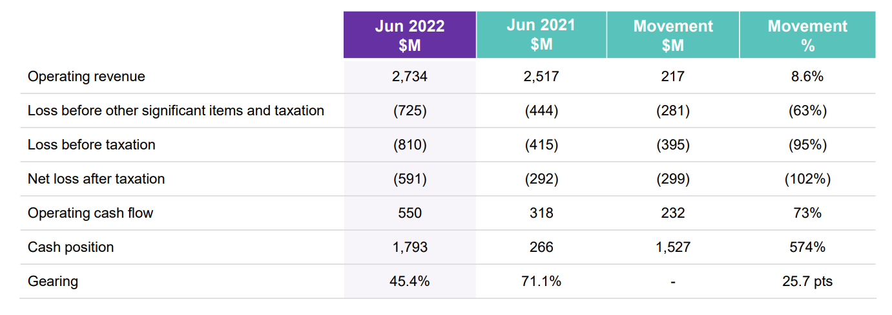

Slide 11
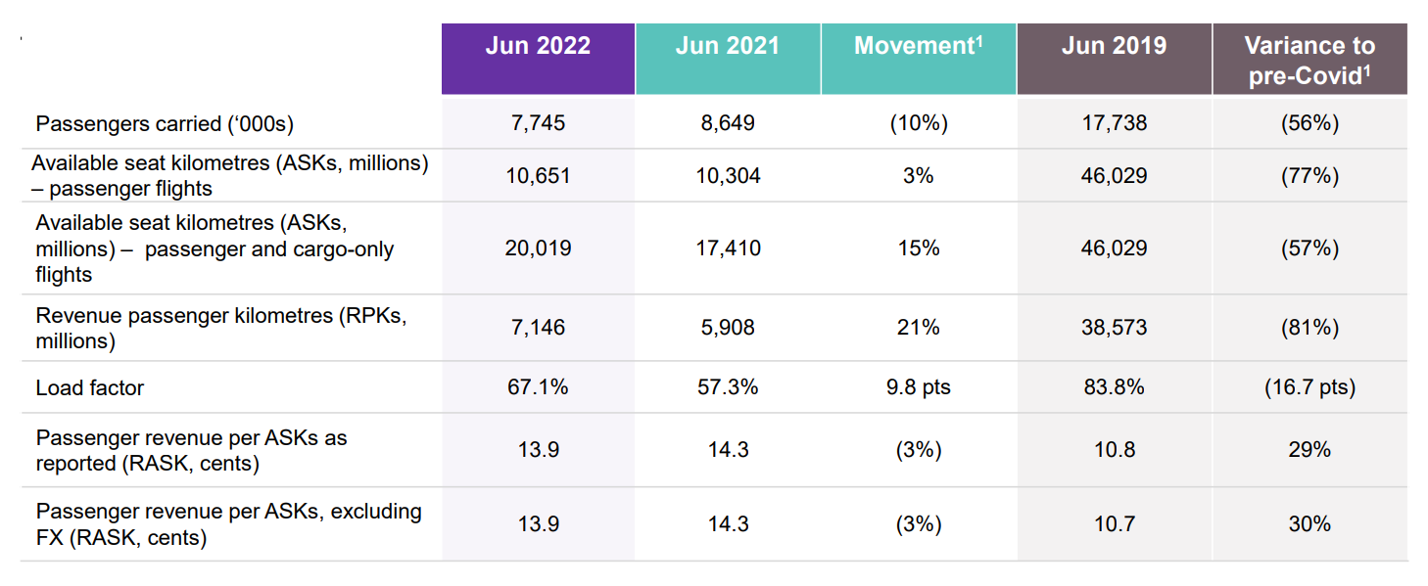
PASSENGERS
During FY22, Air New Zealand carried 6.84 million domestic and 909,000 International passengers.
In 2019 it carried 11.5 million domestic and 6.22 million international.
In those two years, total passengers have dropped from 17.72 million to 7.75 million, with 2022 the lowest in the pandemic era.
Revenue passenger kilometers have dropped from 38.57 million to 7.2 million

Slide 12
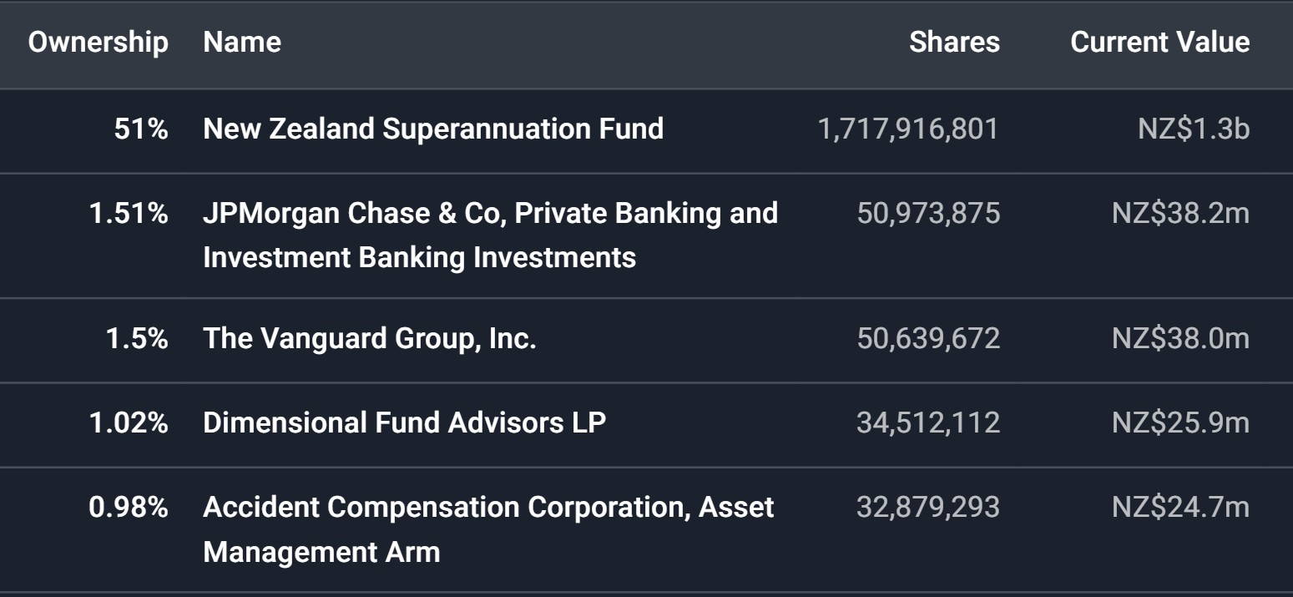
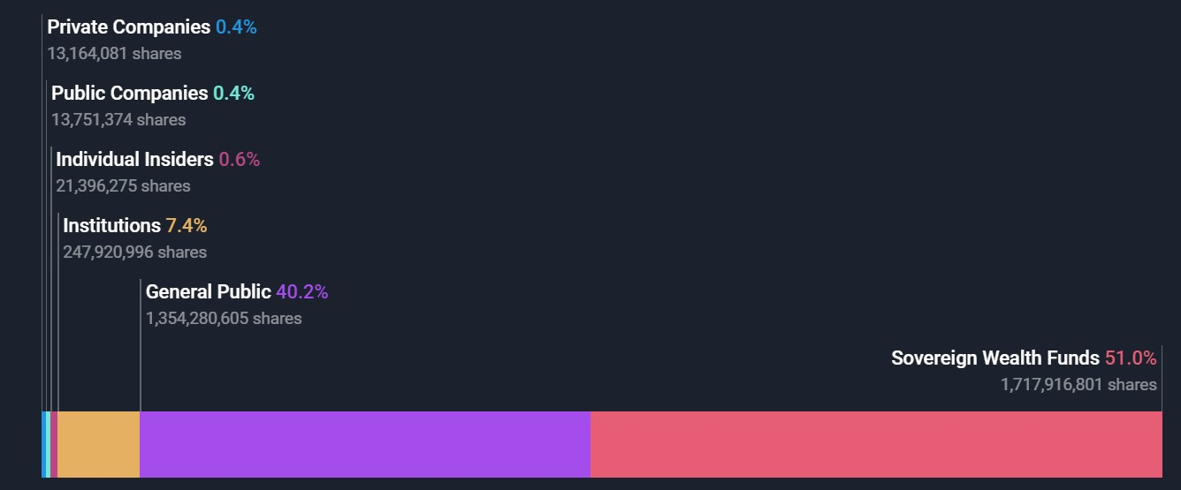
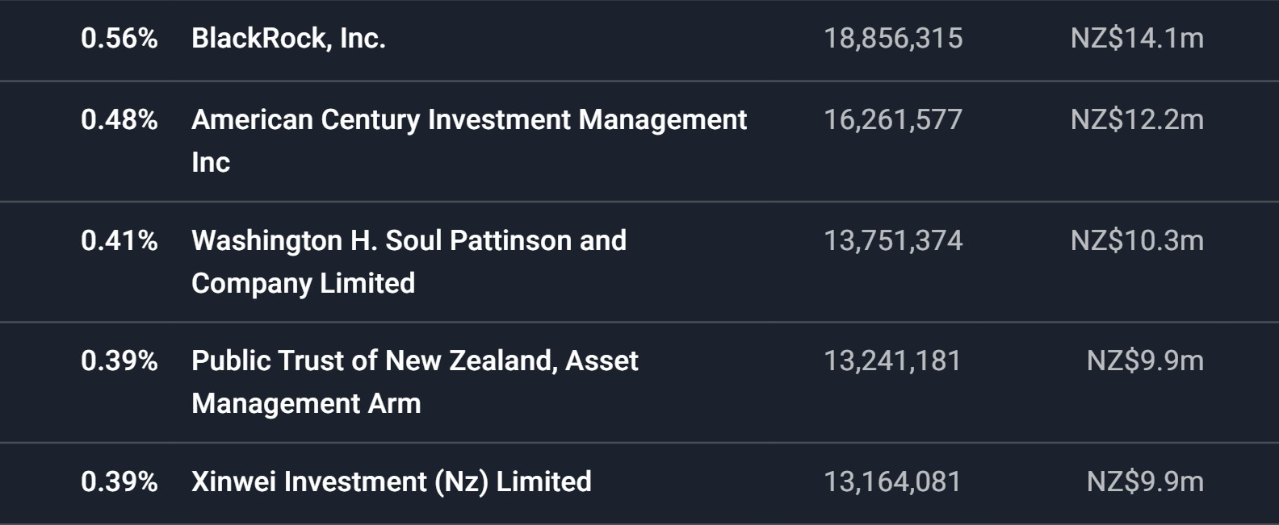
OWNERSHIP & SHAREHOLDERS(TOP 10)

Slide 13
COMPETITORS
AIR FRANCE – KLM SA(FRANCE)
Number of employees – 73,719
Revenue - $16.9B
Qantas Airways Ltd(AUSTRALIA)
Number of employees – 33,265
Revenue - $16.5B
Cathay Pacific Airways Ltd(HONG KONG)
Number of employees – 20,800
Revenue - $5.9B
Capital A Bhd(MALAYSIA)
Number of employees – 14,778
Revenue - $443.3M

Slide 14
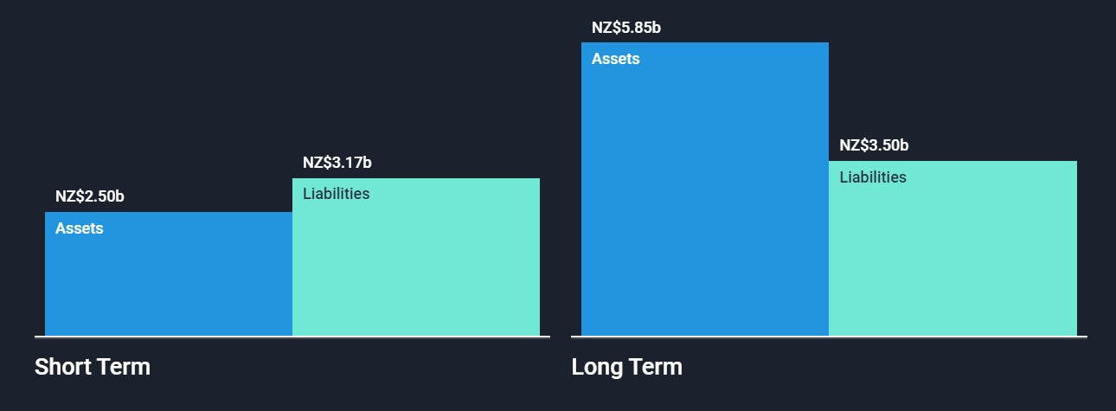
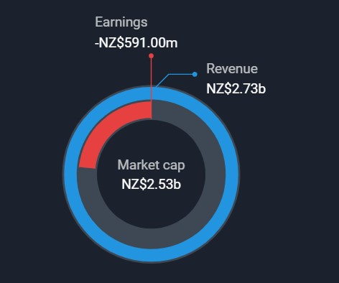
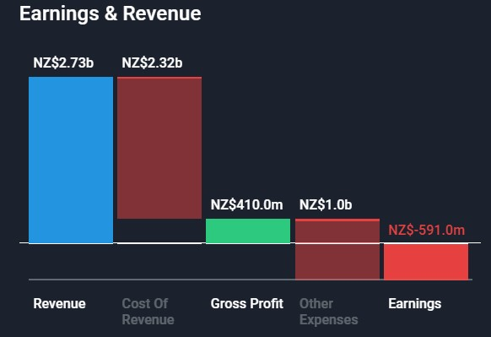
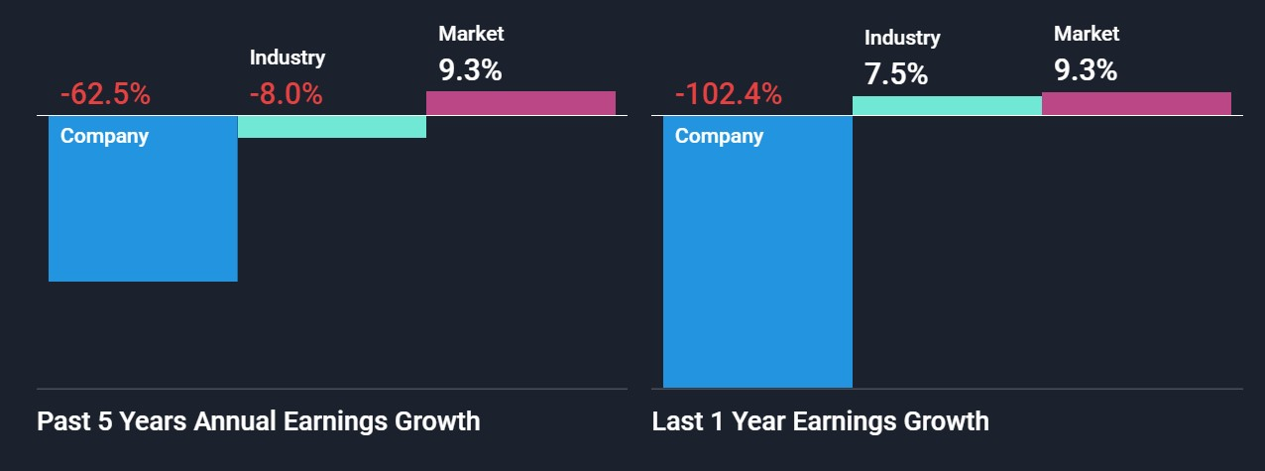
FINANCIAL ANALYSIS

Slide 15
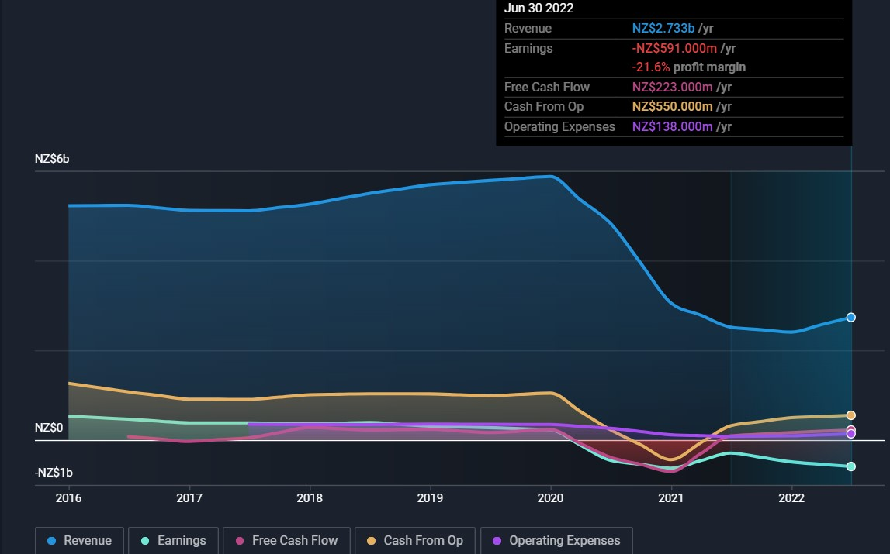

Slide 16
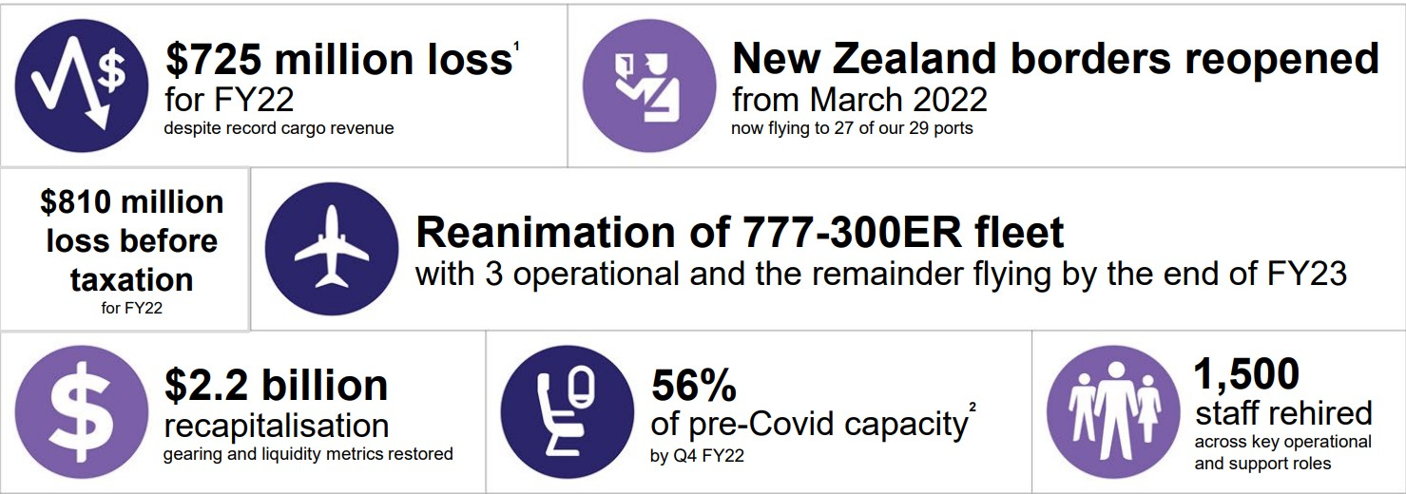
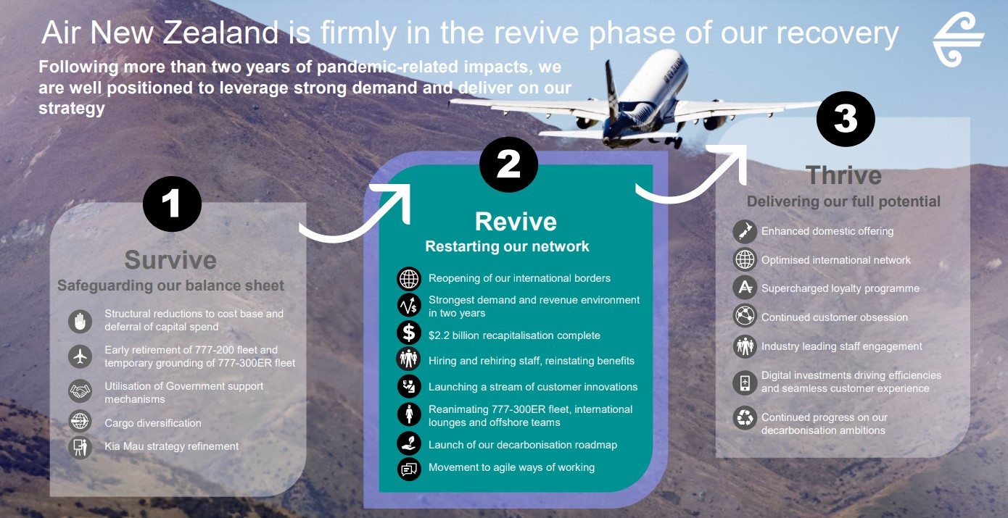

Slide 17
PASSENGER TRAFFIC STATISTICS
Market Size And Growth Estimation
S. No. | TRAFFIC | UNIT | 2020-21 | 2021-22
(1) | (2) | (3) | (5) | (4)
1. | Domestic Passengers | Departing Passengers | 53.3 million | 84.2 million
 |  |  | (-62.2 %) | (57.9%)
2. | Domestic Airline Demand | Revenue Passenger Kilometers (RPK) | 52.9 billion | 81.8 billion
 |  |  | (-61.3%) | (54.5%)
3. | Domestic Airline Capacity | Available Seat Kilometers (ASK) | 77.4 billion | 111.5 billion
 |  |  | (-51.2%) | (44.1%)
4. | International Passengers | Departing and Arriving Passengers | 8.8 million | 21.2 million
 |  |  | (-85.5%) | (141.0%)
Total Passengers (Domestic & International) |  |  | 62.1 million | 105.4 million
 |  |  | (-69.3%) | (69.6%)
On the basis of the government report in FY 2021-2022 total passengers were 105.4 million
Forecasting:-
In FY 2022-2023 – 146 million
India likely to have 400 million air travelers by 2027
Expected passengers to be four times 560 million by 2037.

Slide 18
Passenger traffic trends y-o-y.
Market Demand Over the Year
The domestic passenger traffic registered a compound annual growth rate (CAGR) of 3.3% during the period 2011-12 to 2021-22 while the international passenger traffic grew at -5.7% (CAGR) during the same period.
India has seen a loss for FY2020-21 due to the COVID-19 pandemic. The estimated net loss by ICRA for the fiscal year 2020-2021 was INR 210 billion ($2.70 billion).

Slide 19
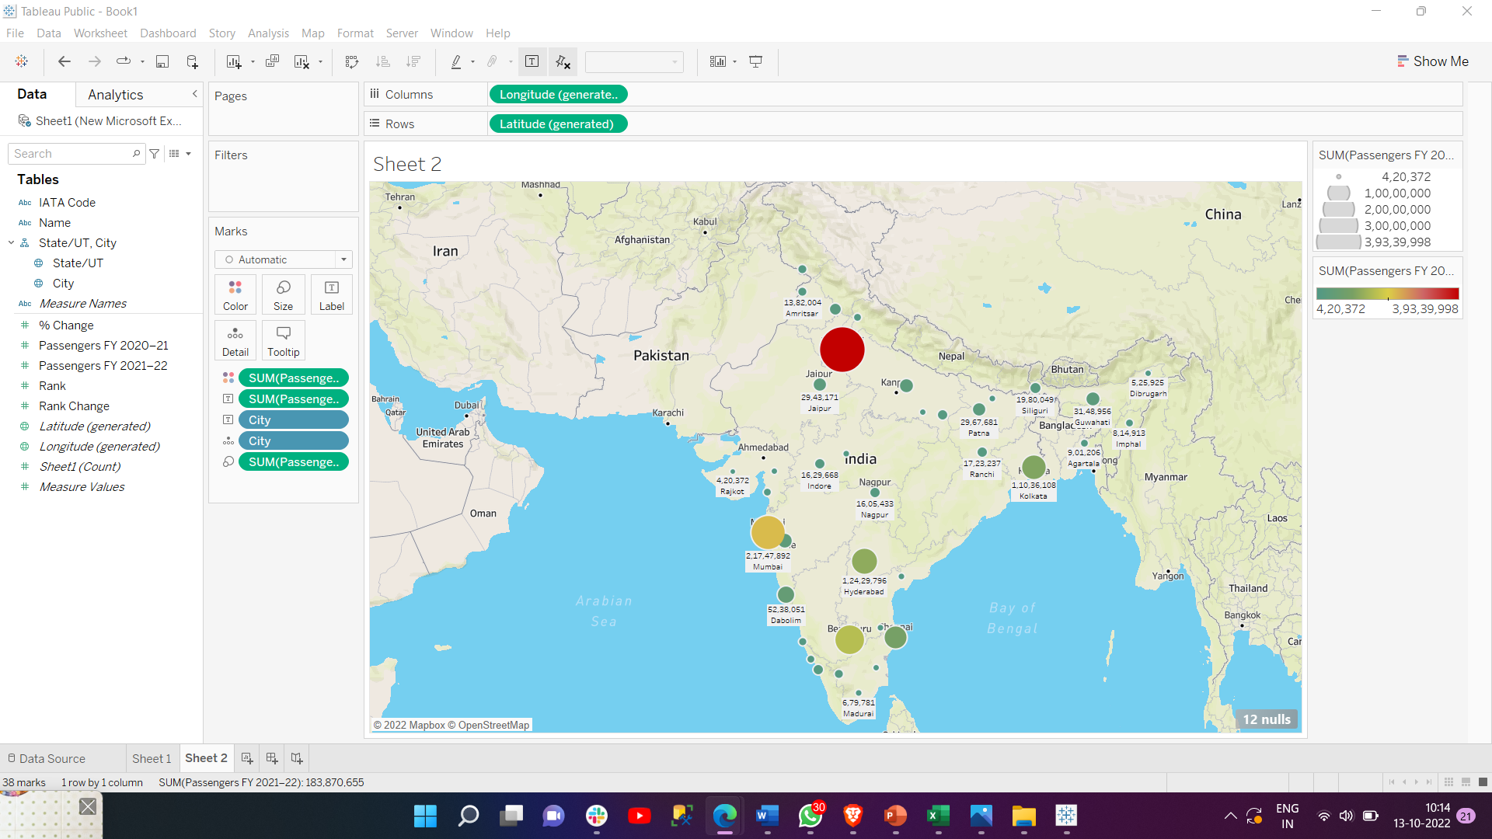
Passenger distribution among different City's
Market entry framework:-Geography/Demographic
Rank | City | State/UT | IATA Code | Passengers FY 2021–22 | Passengers FY 2020–21
1 | New Delhi | Delhi | DEL | 3,93,39,998 | 2,25,83,736
2 | Mumbai | Maharashtra | BOM | 2,17,47,892 | 1,10,54,811
3 | Bengaluru | Karnataka | BLR | 1,62,87,097 | 1,09,14,194
4 | Hyderabad | Telangana | HYD | 1,24,29,796 | 80,48,248
5 | Kolkata | West Bengal | CCU | 1,10,36,108 | 77,28,906
6 | Chennai | Tamil Nadu | MAA | 95,33,301 | 54,95,707
7 | Ahmedabad | Gujarat | AMD | 56,70,896 | 36,42,413
8 | Dabolim | Goa | GOI | 52,38,051 | 28,90,545
9 | Kochi | Kerala | COK | 47,17,777 | 24,58,458
10 | Pune | Maharashtra | PNQ | 37,13,491 | 21,37,859
11 | Lucknow | Uttar Pradesh | LKO | 33,03,960 | 24,41,037
12 | Srinagar | Jammu and Kashmir | SXR | 31,58,400 | 18,02,904
13 | Guwahati | Assam | GAU | 31,48,956 | 21,89,135
14 | Patna | Bihar | PAT | 29,67,681 | 27,10,000
15 | Jaipur | Rajasthan | JAI | 29,43,171 | 18,50,187
Target :- Top 5 cities in the table contribute 65% of the domestic passenger.
Delhi, Mumbai, Bengaluru, and Hyderabad are having 70% cargo Volume.

Slide 20
Market Size Estimation
Market Size (potential guesstimate) on the basis of growth.
As per the Government data near about 4 lakhs of passengers daily. So, 4lakhs x 365 =14.6 crore per annum.
As per the data 22 % growth rate of passengers per annum.
By 5 years India reach 40 crore passengers per annum. Means in 5 years 2.75 times passenger per annum increase.
As of now, India’s aviation sector has a 680 fleet size. On the bases of the data, we can say Indian aviation is required to increase its airplane fleet up to 1100 planes. So, Air New Zealand can work to fulfilling the fleet gap of 420 planes.

Slide 21
Market share (%) in terms of domestic market demand (RPK)-2021-22
Industry Analysis:- Competitors.
Sl. No. | Name of the Airline | Passengers (In Number) |  |  | PLF (%)
 |  | 2020-21 | 2021-22 | YoY Growth (%) | 2020-21 | 2021-22 | CHANGE (+/-)
(1) | (2) | (3) | (4) | (5) | (6) | (7) | (8)
1. | AIR ASIA | 3609627 | 4785571 | 32.6 | 64.1 | 70.1 | 6.0
2. | AIR INDIA | 4781615 | 8166932 | 70.8 | 65.6 | 68.6 | 3.0
3. | AIR INDIA EXPRESS | 22754 | 17893 | -21.4 | 28.6 | 50.4 | 21.8
4. | AIR TAXI | 183 | 221 | 20.8 | 23.0 | 34.7 | 11.7
5. | ALLIANCE AIR | 705273 | 1077709 | 52.8 | 51.1 | 59.8 | 8.7
6. | FLYBIG | 7238 | 81268 | 1022.8 | 44.9 | 51.1 | 6.2
7. | GO AIR | 4018264 | 7970284 | 98.4 | 66.6 | 75.1 | 8.5
8. | INDIGO | 29336170 | 46606224 | 58.9 | 68.7 | 73.5 | 4.8
9. | PAWAN HANS | 1331 | 1530 | 15.0 | 20.4 | 23.7 | 3.4
10. | SPICEJET | 7086585 | 8386574 | 18.3 | 75.7 | 80.4 | 4.8
11. | STAR AIR | 112239 | 199633 | 77.9 | 72.3 | 73.5 | 1.2
12. | TRUJET | 277862 | 147549 | -46.9 | 54.0 | 47.1 | -6.9
13. | VISTARA | 3,371,361 | 6,743,071 | 100.0 | 67.2 | 73.2 | 6.1
In the year 2021-22 both in terms of RPK and passengers carried, IndiGo had the maximum market share with near about 55% followed by SpiceJet, Air India and Go Air.

Slide 22
Approximate cost structure of aviation industry in India
Expenditure Analysis
While decomposing the airline industry cost structure, it can be seen that highest cost accounts for Depreciation and amortization at 26.5% followed by Fuel (19.8%) of the total Operating Cost of the Indian aviation industry.
One of the major challenges faced by companies is the price of Aircraft Fuel increasing rapidly after the pandemic & Ukraine war.
Even Flights Equipment cost also increased, which affect the revenue of the company.

Slide 23
Financial summary of all scheduled Indian carriers- 2020-21
S. No. |  | Airlines | Operating Revenue | Operating Expenses | Operating Result
(1) |  | (2) | (3) | (4) | (5)
(RS. IN MILLION)
(A) | Scheduled National Carriers
1. | AIR INDIA |  | 103,376.80 | 150,386.40 | -47,009.60
2. | AIR INDIA EXPRESS |  | 20,394.15 | 18,896.52 | 1,497.63
3. | ALLIANCE AIR |  | 4,535.40 | 6,784.60 | -2,249.20
SUBTOTAL (A) |  |  | 128,306.35 | 176,067.52 | -47,761.17
(B) | Scheduled Domestic Private Carriers
4. | AIR ASIA |  | 13,587.20 | 27,547.50 | -13,960.30
5. | BLUE DART |  | 7,770.00 | 6,880.00 | 890.00
6. | GO AIR |  | 23,261.94 | 26,696.10 | -3,434.16
7. | INDIGO |  | 146,406.31 | 198,337.26 | -51,930.95
8. | SPICE JET |  | 51,333.77 | 65,170.45 | -13,836.68
9. | STAR AIR |  | 733.38 | 920.83 | -187.44
10. | TRUJET |  | 1,368.58 | 3,111.58 | -1,743.00
11. | VISTARA |  | 22,434.90 | 39,185.80 | -16,750.90
SUBTOTAL (B) |  |  | 266,896.09 | 367,849.52 | -100,953.43
GRAND TOTAL (A+B) |  |  | 395,202.44 | 543,917.04 | -148,714.60
INSIDES FROM THE TABLE:-
Almost every company in the aviation sector faces losses in past years.
The company like Blue Dart & Air India Express are in profit because there are working in the aviation cargo sector.
Indigo is facing the highest loss because of its wide operating fleet size. But in the future, Indigo recover its losses and move toward profits because of its highest growth rate.

Slide 24
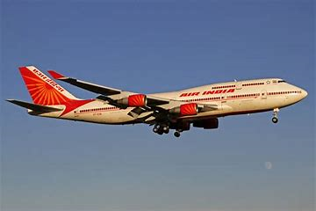
Now let’s understand Indian cargo marker
Target Segment.
S. No. | Cargo Traffic | 2020-21 | 2021-22
(1) | (2) | (3) | (4)
1. | DOMESTIC | 4.68 lakh MT | 6.05 lakh MT
 |  | (-35.6) | (29.4)
2. | INTERNATIONAL* | 10.1 lakh MT | 14.26 lakh MT
 |  | (-34.8) | (41.6)
Note: Figures in parenthesis refer to percentage change over previous year; MT: Metric Tonne. * International Cargo figures include Freight only.
Domestic cargo traffic registered a growth of 2.9% (CAGR) over the period from 2011-12 to 2021-22 while International cargo traffic grew at 1.6% (CAGR) during the same period.
The proportion of total domestic cargo carried as belly cargo registered positive growth of 5.1% in the FY 2021-22 as compared to last year. In financial year 2021-22 the dedicated cargo carrier was Blue Dart Airline only.
Due to poor passenger demand, many airlines retooled their business strategies to meet the moment, with an emphasis on cargo, in order to mitigate the losses they were suffering.

Slide 25
Indian cargo market status in aviation sector
Market Analysis
Indian Cargo market shows a 12% annual growth rate in the last decade.
Blue Dart, Air India Express, and Spice Jet Express are the major competitor for New Zealand Airlines. Blue Dart dominates the Indian market with a 25% share in the cargo market.
E-commerce as of now $41 billion market and expected to grow to five times its current size in India by 2026, a putative $200 billion market poised to materialize in less than five years. Which is the major cause of the booming of the Indian cargo market.
Delhi, Mumbai, Bengaluru, and Hyderabad are having 70% cargo Volume. So, Air New Zealand should focus on these cities.
India has only 25 Dedicated Freighter aircraft and on the other hand country like Kenya/Indonesia more Dedicated Cargo aircraft.

Slide 26
Operating cost per ASK, 2020-21
Operational Feasibility
The cost comparison was undertaken before and after adjusting Operating Cost to Average Stage Length. Because of high fixed cost of airlines unit cost decrease as distance increases. Hence, a stage length adjustment is necessary for fairer comparison. In the year 2020-21, Go Air and IndiGo had the least Adjusted Operating Cost Per ASK (adjusted for stage length) i.e. Rs 3.5 and 3.9 respectively. In the same year, Alliance Air and Trujet had the highest Adjusted Operating Cost Per ASK (adjusted for stage length) i.e. Rs.9.9 and 8.9 respectively.

Slide 27
Operating cost per ASK, 2020-21 (comparison)
Operating Cost Per ASK of Air New Zealand is 11.15 cents (in Rs 5.12)
Go Air and IndiGo had the least Adjusted Operating Cost Per ASK (adjusted for stage length) i.e. Rs 3.5 and 3.9 respectively.
In the same year, Alliance Air and Trujet had the highest Adjusted Operating Cost Per ASK (adjusted for stage length) i.e. Rs.9.9 and 8.9 respectively.
IndiGo has 55% of the Aviation passenger Market. So, Air New Zealand has to compete with IndiGo and compete with Operating cost per ASK of IndiGo (Rs 3.5).

Slide 28
Opportunities in India Aviation Sector.
Market Growth & Trends.
In the next four years, the Indian Aviation industry may look into USD 5 billion worth of investment and anticipate nearly 25 Billion foreign investment to enter the airport sector by 2027.
Indian Aviation Industry is the fastest-growing aviation industry in the world and is set to be the third-largest aviation market in the world by 2024.
India’s aviation market become globalized with 100% foreign direct investment.
As of now, we reach the 4-lakh daily passenger mark means 14.6 CR per year. India likely to have 40 cr air travelers by 2027.
As time ticks away, we are here eventually becoming the fastest-growing aviation market and owning 128 operational airports as of now. Which can reach 180+ in the future.
Further, the rising demand in the sector has pushed the number of airplanes operating in the sector. The number of airplanes is expected to reach 1,100 planes by 2027. As of now, we have 698 planes

Slide 29
Challenges faced by the aviation Industry in India
Shortage of trained employee
There is a shortage of trained and skilled manpower in the aviation sector because of which there is cut-throat competition for employees; thereby driving wages to unsustainable levels.
Regional connectivity
Though there are a large number of airlines operating, still there is lack of regional connectivity
Providing regional connectivity is one of the greatest challenges for the Aviation sector in India. This is due to lack of airports and other associated infrastructure
Rising fuel prices
The jet fuel cost accounted for nearly 45% to 50% of the total costs in 2018; thereby presenting more operational challenges
Declining yields
Pricing and yield are the key elements for an airline to operate
Commercial liberalization has led to intense competition and reduction in real yields for Airline companies.
Gaps in Infrastructure
Airport infrastructure and Air Traffic Control (ATC) foundation are insufficient to help development
While a beginning has been made to redesign the infrastructure, the outcomes will be visible after some years.
Technical Challenges
The maintenance, Repair, and Overhaul (MRO) industry is not well developed in India; to provide for cost-effective maintenance of Aircrafts
The lack of native Aircraft manufacturing base, results in more imports of Aircrafts, thereby making the operations more Capital Intensive

Slide 30
Proportion of domestic cargo carried as belly cargo and in dedicated freighters
The proportion of total domestic cargo carried as belly cargo registered positive growth of 5.1% in the FY 2021-22 as compared to last year. In the financial year, 2021-22 the dedicated cargo carrier was Blue Dart Airline only.
In 2022 government made a limit of 65% for cargo in Belly hold. So in the future, we can see an increase in Dedicated cargo shear in the Domestic Cargo market.

Slide 31
RISKS
BEFORE ENTERING THE MARKET
Shortage of trained employee
There is a shortage of trained and skilled manpower in the aviation sector because of which there is cut-throat competition for employees; thereby driving wages to unsustainable levels.
Regional connectivity
Though there are a large number of airlines operating, still there is lack of regional connectivity
Providing regional connectivity is one of the greatest challenges for the Aviation sector in India. This is due to lack of airports and other associated infrastructure
Rising fuel prices
The jet fuel cost accounted for nearly 45% to 50% of the total costs in 2018; thereby presenting more operational challenges
Declining yields
Pricing and yield are the key elements for an airline to operate
Commercial liberalization has led to intense competition and reduction in real yields for Airline companies.
Gaps in Infrastructure
Airport infrastructure and Air Traffic Control (ATC) foundation are insufficient to help development
While a beginning has been made to redesign the infrastructure, the outcomes will be visible after some years.
Technical Challenges
The maintenance, Repair, and Overhaul (MRO) industry is not well developed in India; to provide for cost-effective maintenance of Aircrafts
The lack of native Aircraft manufacturing base, results in more imports of Aircrafts, thereby making the operations more Capital Intensive

Slide 32
DURING OPERATIONS
System Failure and Aging Technology Infrastructure. An unfortunate number of examples demonstrate the far-reaching effects of a major airline’s system outage.
Pilot Shortage.
Climate Change.
Oil Price Volatility.
Reputation Damage.
Economic Recession.
Government Shutdown.
Decreasing Insurance Capacity.
FUTURE RISK
Privatization and modification of Indian railways
Oil Price Volatility.
Economic Recession.
Climate Change.
Gaps in Infrastructure
Pax Service can vary by time on the basis of government guidelines in future.

Slide 33
BREAKEVEN PERIOD(GUESSTIMATE)
Estimated investment - $2B
Estimated cost of Airbus - $120M
Estimated cost of ATR72 600 - $80M
Average Passenger capacity of Airbus – 172
Average Passenger capacity of ATR72 – 70
Number of Airbus can be purchased – 10
Cost of 10 Airbus – 10*$120M = $1200M
Number of ATR72 can be purchased – 10
Cost of 10 ATR72 – 10*$80M = $800M
Average time an airplane can fly in Indian domestic market
40 – 60 min
60 – 90 min
90 – 120 min
120 – 150 min

Slide 34
Estimated average time a flight being in air – 8hrs
Estimated n/o flight that can fly for 40 -60 min – 5(ATR72)
Estimated n/o flight that can fly for 60 -90 min - 5 (ATR72)
Estimated n/o flight that can fly for 90 -120 min - 5 (AIRBUS)
Estimated n/o flight that can fly for 120 -180 min - 5 (AIRBUS)
Estimated trip a flight can make in 40 – 60 min – 8
Estimated trip a flight can make in 60 – 90 min - 5
Estimated trip a flight can make in 90 – 120 min - 4
Estimated trip a flight can make in 120 – 180 min – 3
Total trip ATR72 make flying 40 – 60 min – 8*5 = 40
Total trip ATR72 make flying 60 – 90 min – 5*5 = 25
Total trip AIRBUS make flying 90 – 120 min – 4*5 = 20
Total trip ATR72 make flying 120 – 180 min – 3*5 = 15
Average ticket price of a flight flying 40-60 min – Rs 4000
Average ticket price of a flight flying 60-90 min – Rs 5000
Average ticket price of a flight flying 90-120 min – Rs 6000
Average ticket price of a flight flying 120-180 min – Rs 8000

Slide 35
Total amount made in 40 trips by ATR72 flying 40 – 60 min – 40*4000 = 1,60,000
Total amount made in 25 trips by ATR72 flying 60 – 90 min – 25*5000 = 1,25,000
Total amount made in 20 trips by ATR72 flying 90 – 120 min – 20*6000 = 1,20,000
Total amount made in 15 trips by ATR72 flying 120 – 180 min – 15*8000 = 1,20,000
Assuming seat booking capacity of ATR72 and AIRBUS as 80%(Top 5 Indian cities with high air traffic, World safest flight, good maintenance, keeping average fare price less than other competitors, good ambiance)
Therefore n/o seats booked daily for ATR72 = 0.8*70 = 56
N/O seats booked daily for AIRBUS = 0.8*172 = 138 (approx) ~ 140
Total amount made by ATR72 when 56 seats are booked and flying for 40 – 60 min = 56*1,60,000 = 89,60,000
Total amount made by ATR72 when 56 seats are booked and flying for 60 – 90 min = 56*1,25,000 = 70,00,000
Total amount made by AIRBUS when 140 seats are booked and flying for 90 – 120 min = 140*1,60,000 = 2,24,00,000
Total amount made by AIRBUS when 140 seats are booked and flying for 120 – 180 min = 140*1,60,000 = 2,24,00,000
Total amount made in a day by selling tickets = 6,07,60,000
Total amount that can be made in a year = 365*6,07,60,000 = 22,177,400,000 = 2217.74 Cr
Total Investment = $2B = 164,834,560,000 = 16483.456 Cr
Breakeven period = 16483.456 Cr / 2217.74 Cr = 8 Yrs (approx.)

Slide 36
Estimated expenditure on fuel = 20% of ticket fare
Estimated expenditure on Maintenance= 10% of ticket fare
Estimated expenditure on Crews = 10% of ticket fare
Estimated expenditure on airport navigation (security fee) = 10% of ticket fare
Estimated expenditure on airport navigation (airport landing fee) = 10% of ticket fare
Estimated expenditure on airport navigation (terminal use fee) = 10% of ticket fare
Therefore estimated profit = 20% of ticket fare
.

Slide 37
DECISION
Hence as per the estimation Air New Zealand can enter Indian domestic market And will make a profit of 20% annually and a good breakeven period of 8 Years. (Considering that initially they will operate between the top 5 cities with highest air traffic).
Initially Air New Zealand should not go into Cargo planes considering the COVID 19 impact and the budget as cost of cargo planes are quite high.
Cargo Market can be monitored as the Indian cargo market’s can be a leader in future, returning more profit than passengers airlines.
Ministry of Civil Aviation launched the Krishi UDAN 2.0 scheme in October 2021. The scheme proposes assistance and incentive for movement of agriculture-produce by air transportation. The Krishi UDAN 2.0 will be implemented at 53 airports across the country, largely focusing on Northeast and tribal regions, and is expected to benefit farmers, freight forwarders and airlines.
In India, even now most people's mentality is that airplanes are not a safe mode of travel. As a decision maker, we are going to promote our Airlines as the World's safest Flight operators. (Air New Zealand is world safest airline)
Being the world safest flight with good ambiance Air New Zealand can expand their business to other cities of India since they will be in profit (as per estimation). Gov of India also said that till 2027 there will be 200 airports from 128 currently. (Eg : Darbhanga airport ( a small city) has higher traffic than Patna(Capital city of Bihar))

